Slide 1

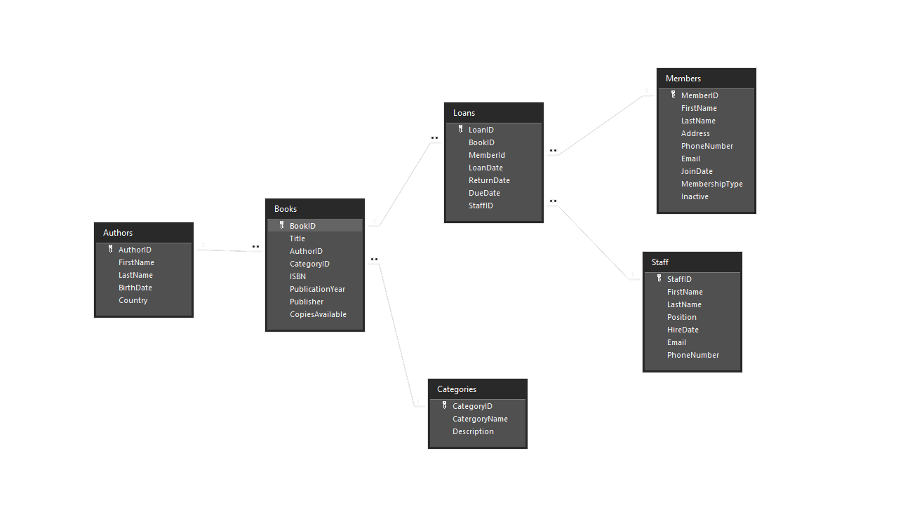
Why you chose this project?
Library Management System
I chose this project for the following reasons:
I am working solo, and this project seemed to have the most achievable requirements that I felt I could confidently deliver on time and completely.
I felt comfortable with being able to come up with solutions to the vague or intangible requests for reports and queries.
My Database Relationship Diagram

Slide 2

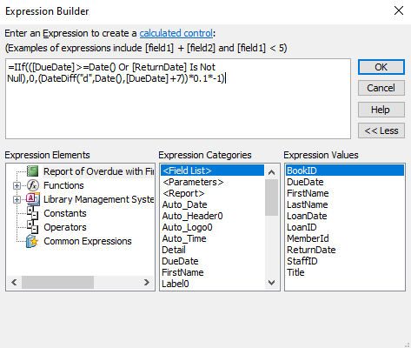
What was your biggest problem and how did you overcome it?
The biggest issue that I had to over come was the fine system. I broke the problem down into sections. I first researched what present fine schedules looked like and how much they charged so that my system was in line with them. I then had to use some programming processes from other classes to figure out the best way to find the solution. I settled on an if statement with an OR logic. The final issue was figuring out how to subtract one date from another. I was able to figure this out after a google search and looking at some similar issues and solutions.
My final equation looks at the due date and compares it to today. It also checks for a blank return date. If either is true it returns nothing for fees. If either is false, it then takes the due date and converts it to a number of days from today and subtracts 7 for a grace period. It then multiplies by .10 for a 10 cent per day fine. Finally, it converts the negative number positive multiplying by -1. I did test with AND logic over OR but could not get it to produce the correct results.

Slide 3


How does your solution fix the problem outlined in the project overview?
My project resolves the solution outlined in the Library Management system overview by:
Implementing all the required tables and relationships
It uses all the required queries and has additional queries where necessary
I have all forms laid out in a easily usable format.
I have included all the required reports and built them in a manner that makes them easy to read and use
I have provided what I think is a easy user interface with navigation

